Slide 1
CERN Mock-up test results
Long run
Setting up the Mock-up
LN2 results
LAr tests
Overall conditions of the test
Stress test and long stay test
Humidity tests
Conclusion
P. Barrillon⁽¹⁾, L. Boistay⁽²⁾, F. Hubaut ⁽¹⁾, P. Pralavorio⁽¹⁾, P. Skensved⁽³⁾, M. Van Uffelen⁽¹⁾, Cryolab⁽²⁾
(1) CPPM, (2) CERN,(3) Queen’s University

Slide 2
Mock-up
Introduction
Determine robustness of calibration system at cold, and during a long period (LN2 then LAr).
 | MU_CShort | MU_CLong | MU_Warm
Purpose | Robustness against ice formation, source blocked, bend, pipe leak |  | Behaviour in bends, DS20k Length
Temp. (K) | LN2 (77) | LN2 (77), LAr (88) | Room (290)
Location | CPPM | CERN | CPPM
Pipe lgth (m) | 4 | 2 | 15 (~DS-20k)
Nb bends | 2 | 1 | 15 (11, 7)
Runs | 09+11/22, 03/23 | 1 month @ June 23 | 03-04/23
Huge thanks to the CERN Cryolab for providing and running the Cryostat, the LN2 and the LAr

Slide 3
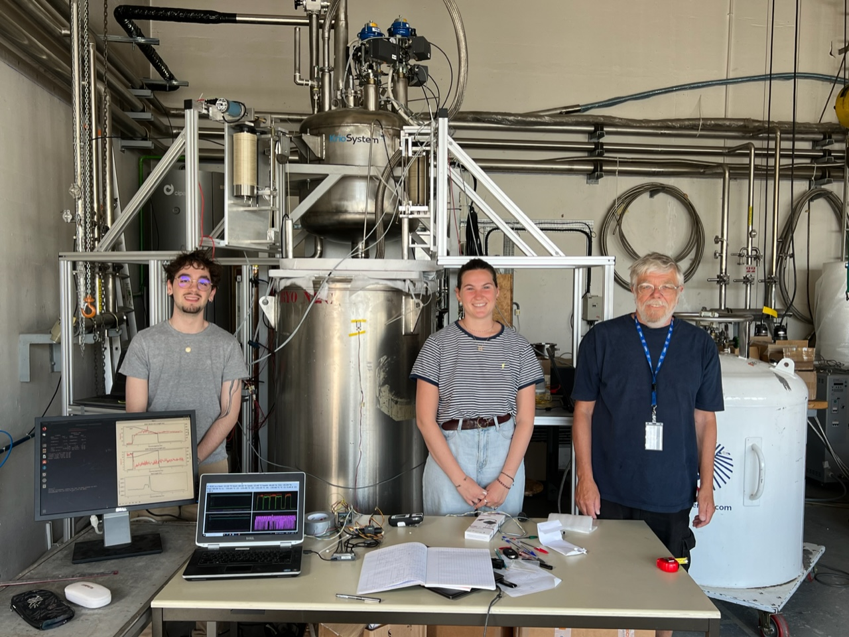
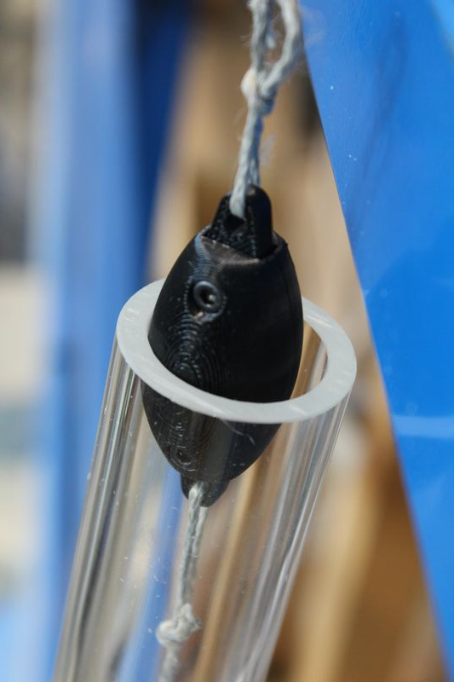
Mock-up
Test’s schedule
LN2
Dewar2
Pseudo–source
L = 5.5cm
φ = 2.5 cm
M= O(100) g
In CERN Cryolab, building 159
30/05-2/06 : Installation
5-9/06 : Settings
9-26/06 : LN2 tests
26/06-03/07 : Warming up Cryo to put LAr
03-17/07 : LAr tests
LN2
Dewar1
Cryo

Slide 4
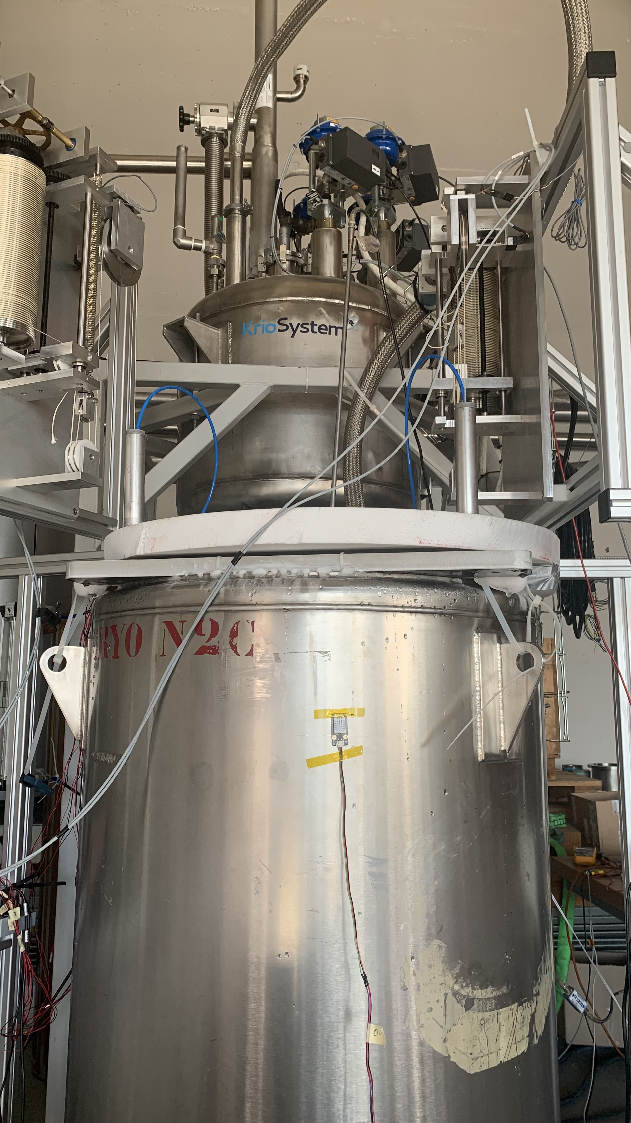
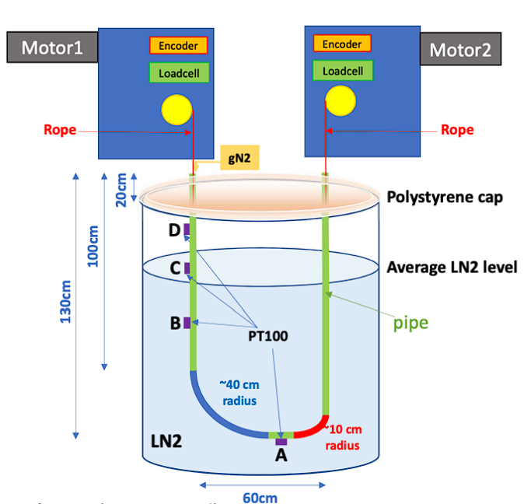
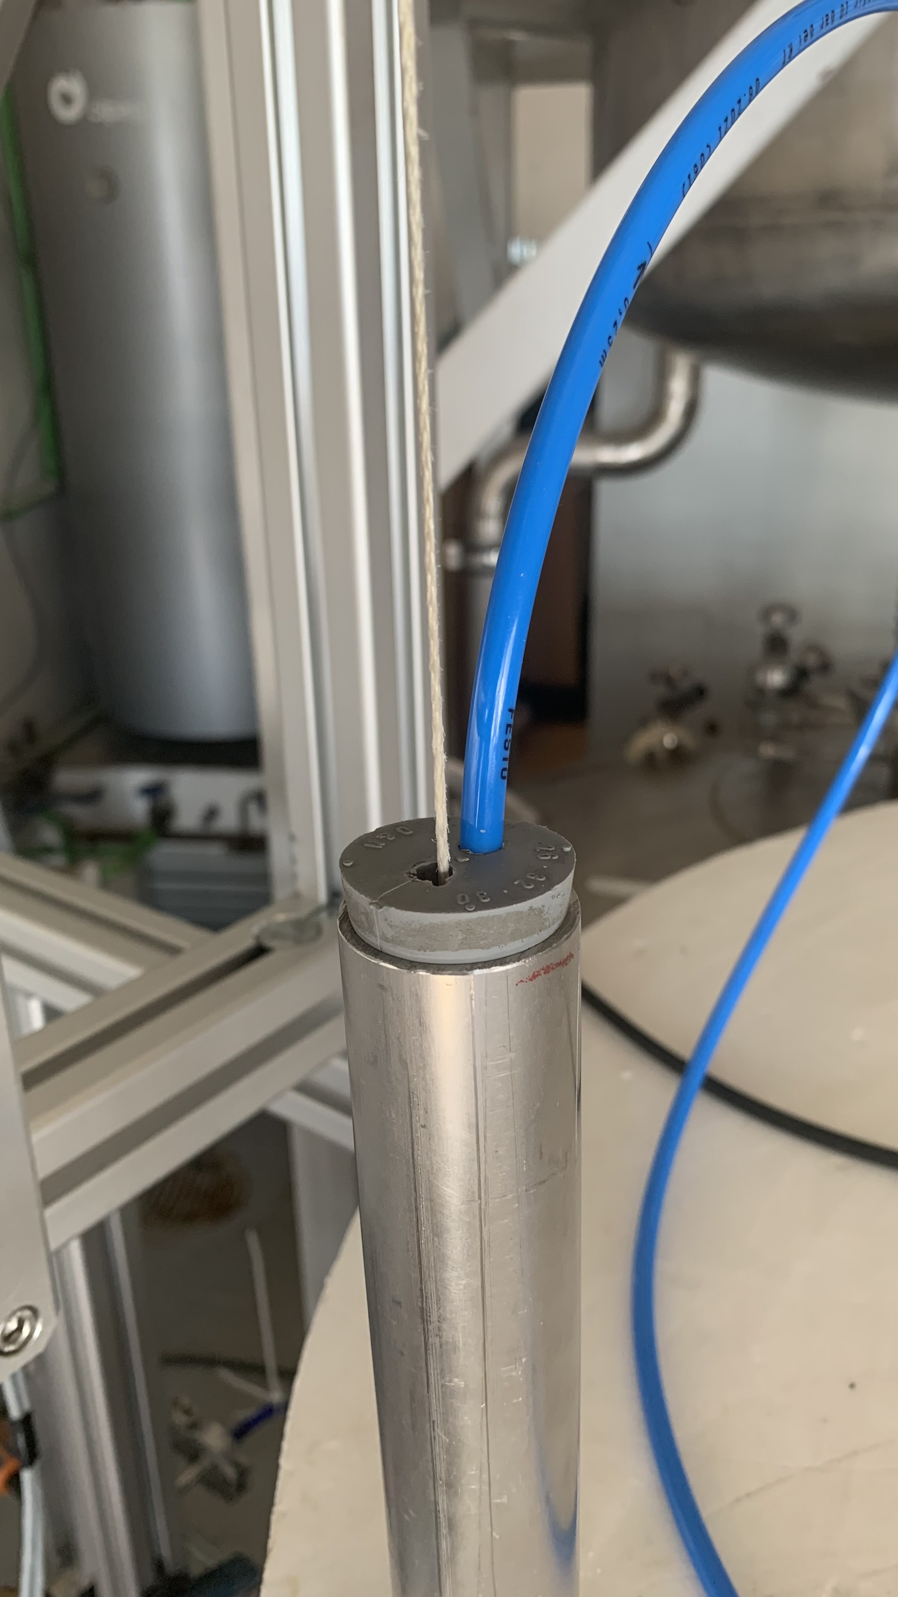
Mock-up
Setup
gN2 flush
DS4
DS2
Rope
LN2
Dewar1
The tube cap is not fully hermetic because of rope and gN2 flushing
The cryostat is not fully adiabatic ➔ Need constant refill with LN2
➔ Only one fill for LAr
4 PT100 probes (A, B, C, D)
1.3 meter of useful tube (from A to D)

Slide 5
LN2 results
18 days of test at LN2 temperature, gN2 flux 60L/h, 3.9% of motor usage (DS20k <1%)
Regular refill of LN2 in cryostat to keep level around 80%
Temperature probes A,B,C below -186 °C
LN2 inside the tube after few hours, and during all the test
LN2 block gN2 flush on right side → Ice formation
Flushing also right side at 250L/h for 1 night
Ice mitigated (turns into frost)
Source moved ~750m (5x DS20k)
Tension stable between 15-30N
Small impact on tension when stopping the source during long periods (1min → 2 days)
D
50cm
C
B
LN2
A
System robust at LN2 temperature
Link to the LN2 presentation

Slide 6
Liquid Argon tests

Slide 7
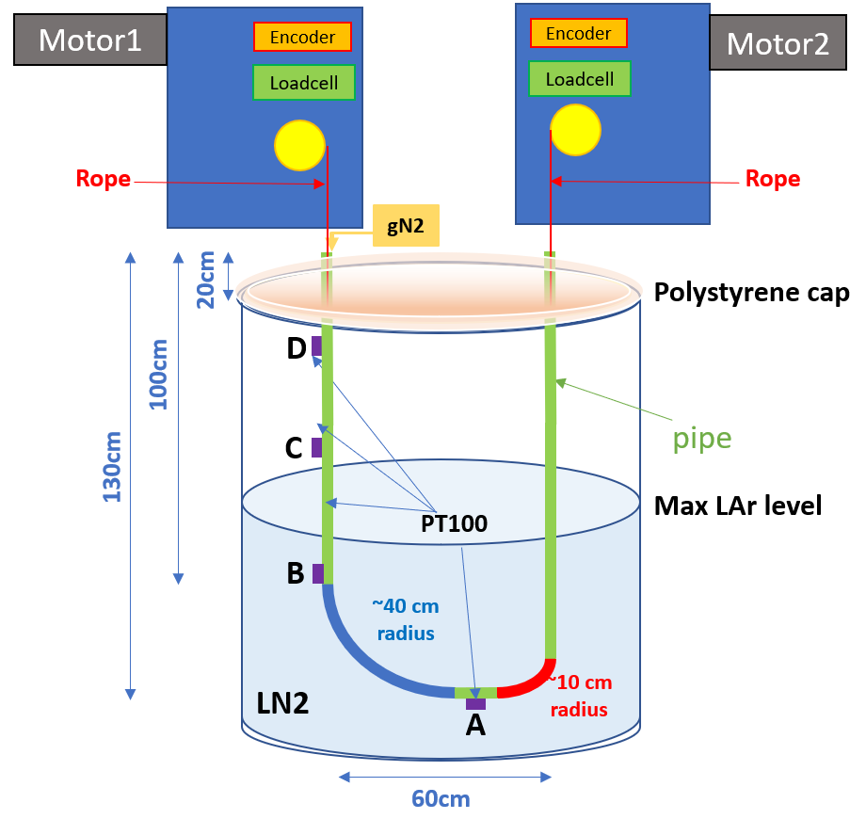
Mock-up – LAr
Setup
gN2 flush
Rope
LN2
Dewar1
+2 humidity sensors
+2 humidity sensors 10cm below
DS4
(left)
DS2
(right)
No liquid in the tube → Flushing gN2 only on left side

Slide 8
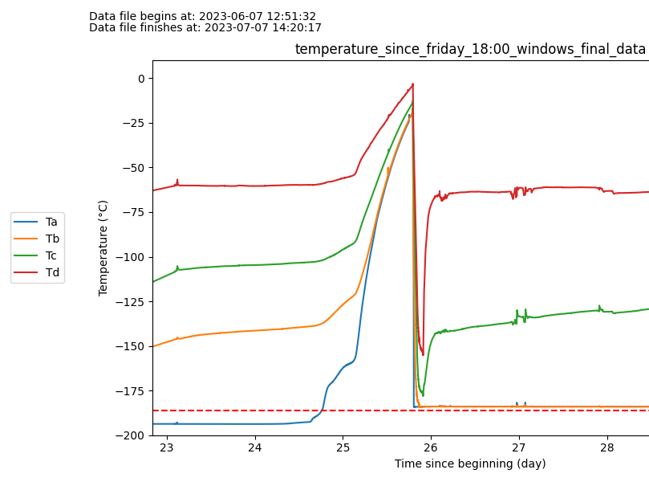
Tank filling with LAr
8
Monday 26/06 : Start the heating process. Small heater placed in the tank.
Thursday 29/06 : Heating process accelerated : larger heater inside the tank, lid of the tank removed → had to move motor system
Friday 30/06 : End of the active heating process, letting tank heat with ambient temperature.
Monday 03/07 : Filling of the cuve with LAr
Saturday
Sunday
Monday
Tuesday
Wednesday
Friday 30/06 – 18h
LAr filling
LAr temperature

Slide 9
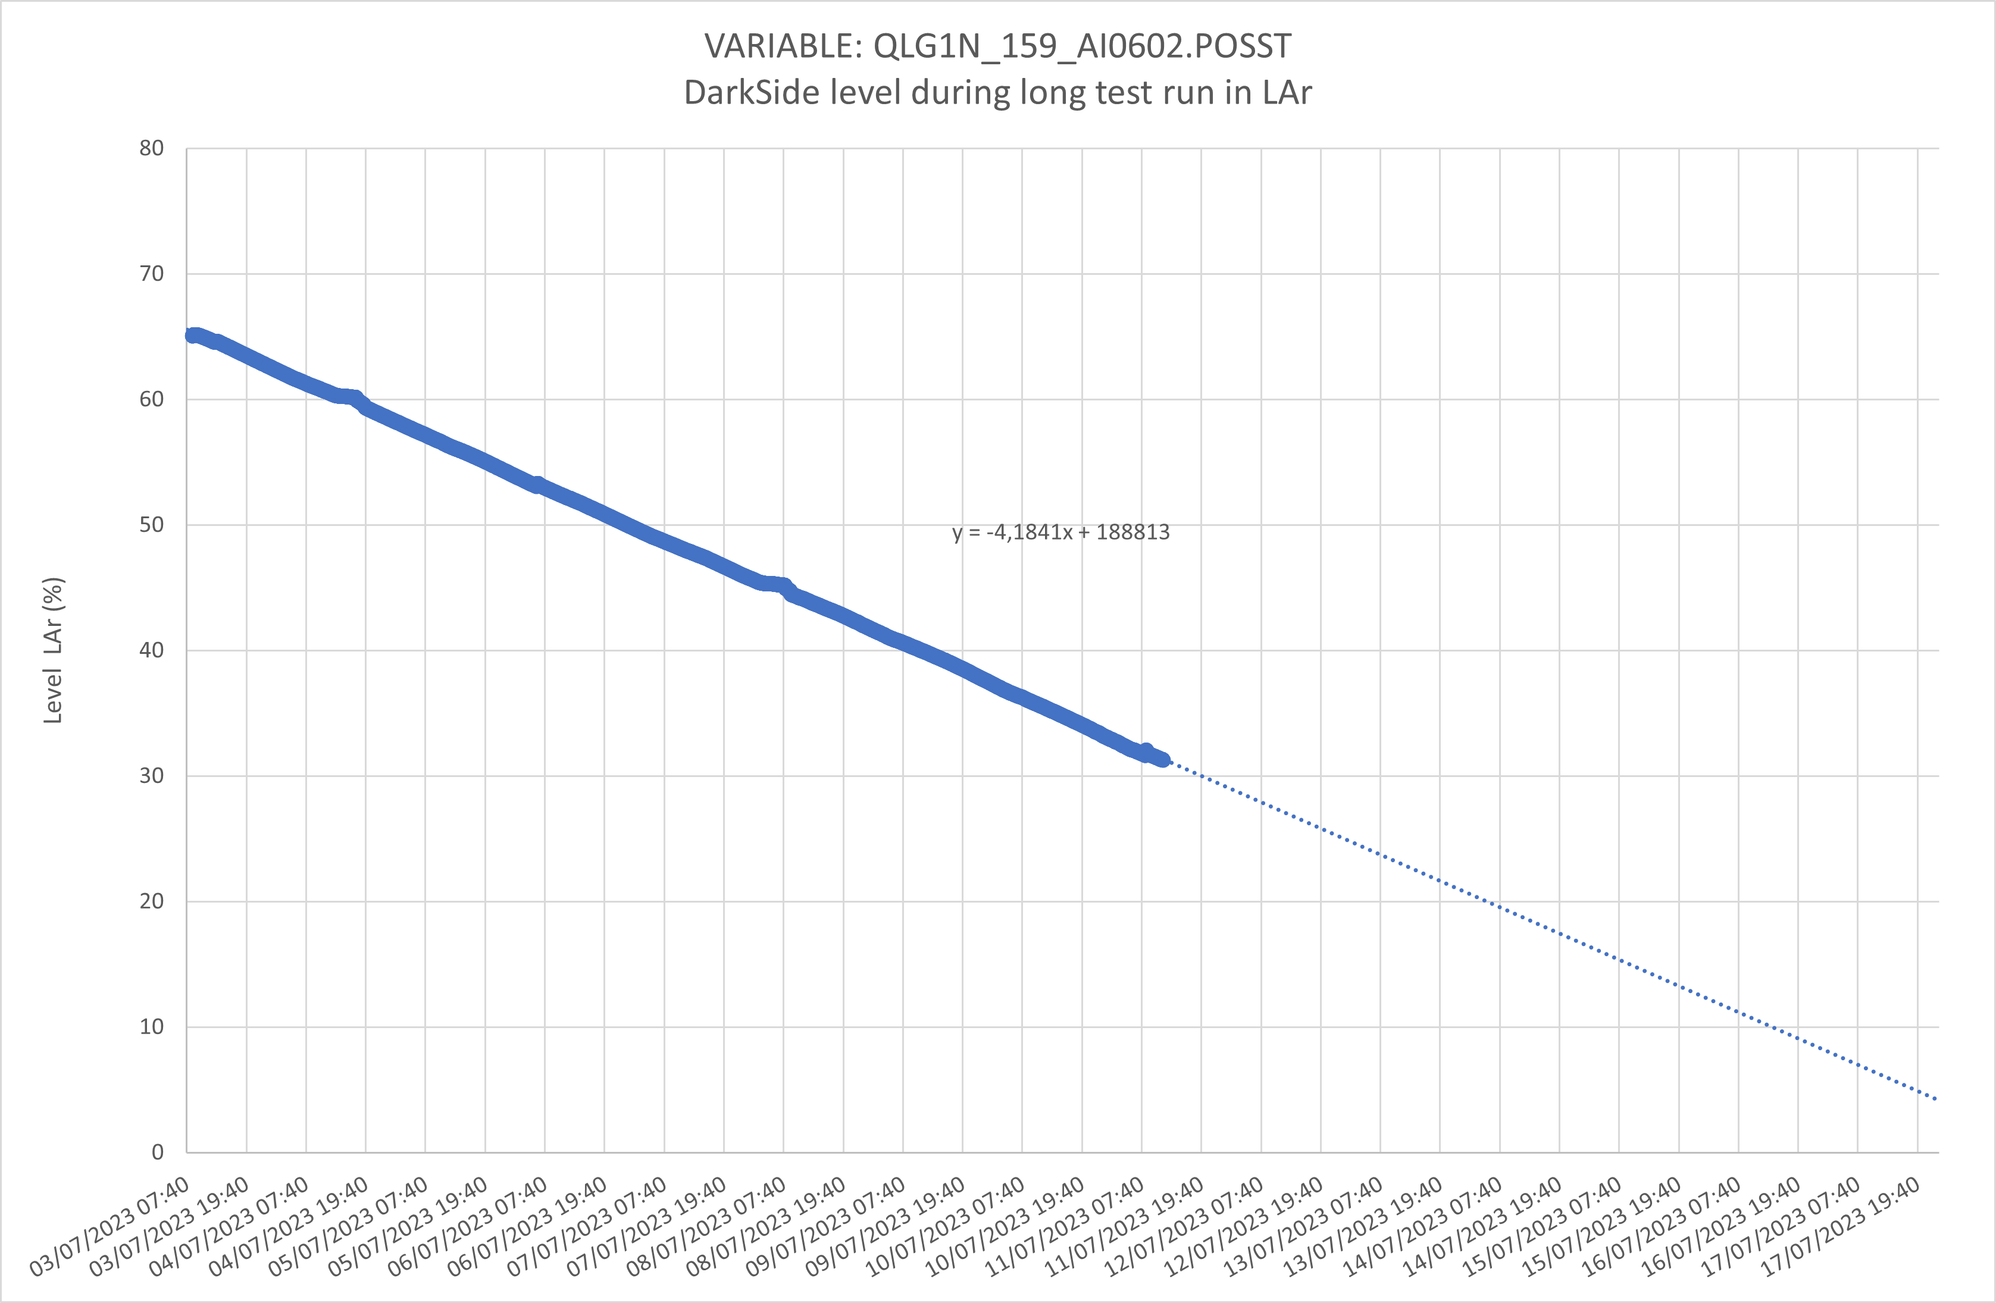
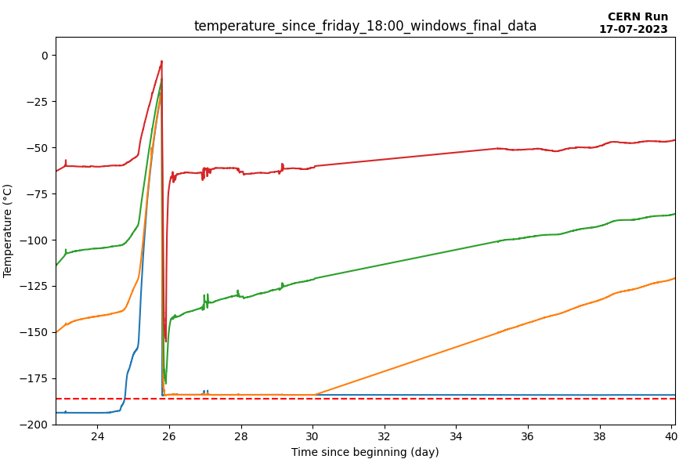
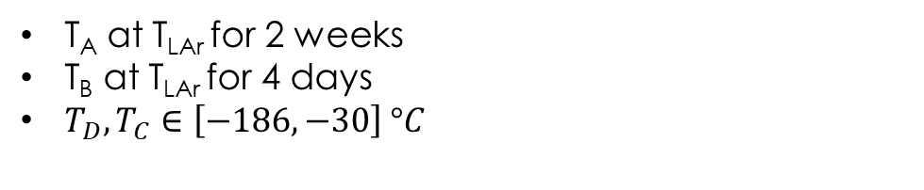
Test conditions for LAr (14 days)
tank filling AND Temperature of PT100
First week
Second week
Second week
200
First week
LAr filling
Slope
4%/day
150
gN2 flow (L/h)
100
50
LAr temperature
0
T_{A} at T_{LAr} for 2 weeks
T_{B} at T_{LAr} for 4 days
$T_{D},T_{C}∈\left[−186, −30\right] °C$
Only one fill of LAr in tank
Flushing at 60L/h
Motorized system used for 0.8% of 2 weeks

Slide 10
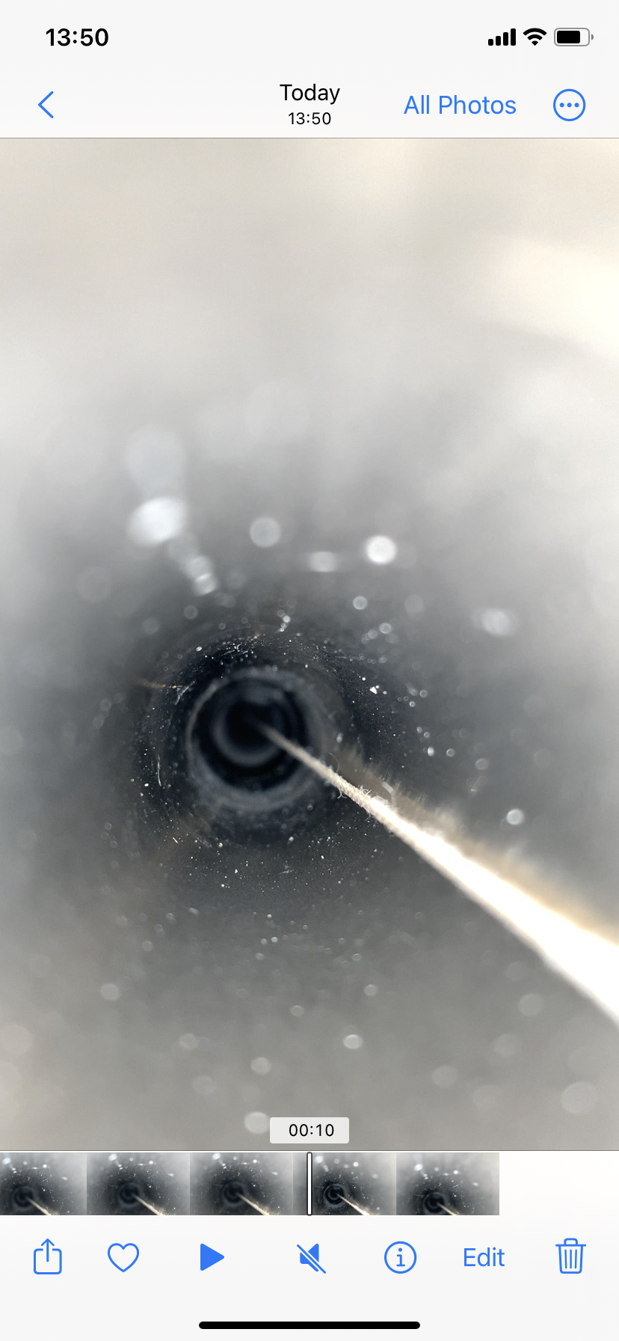
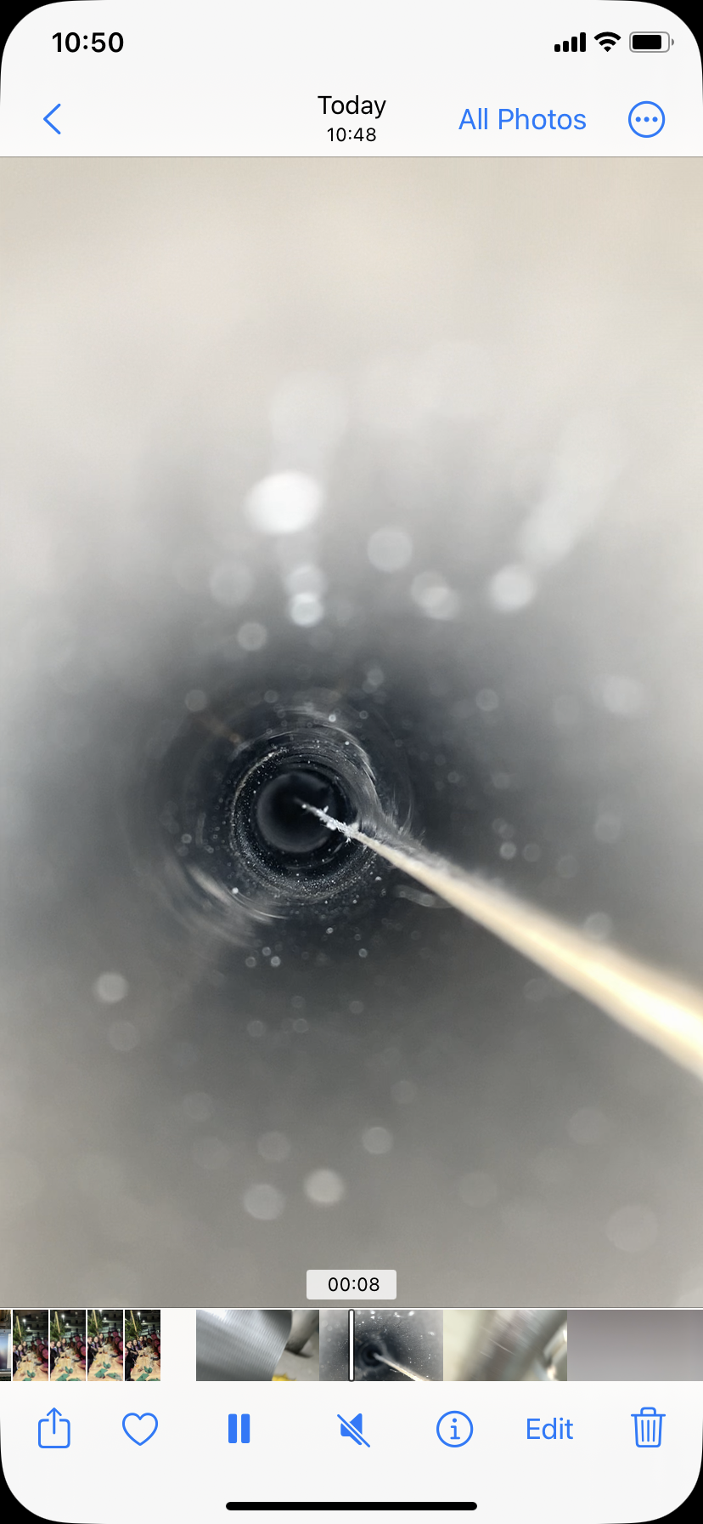
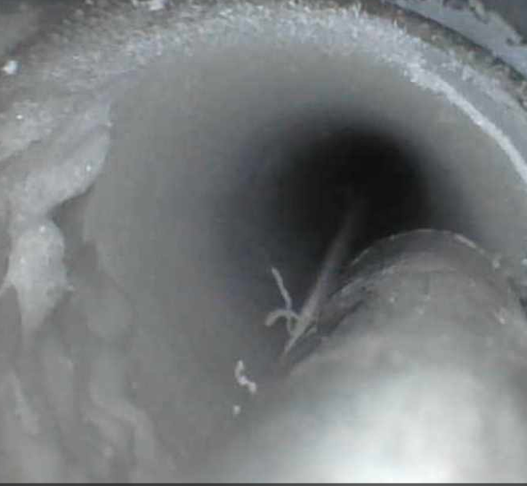
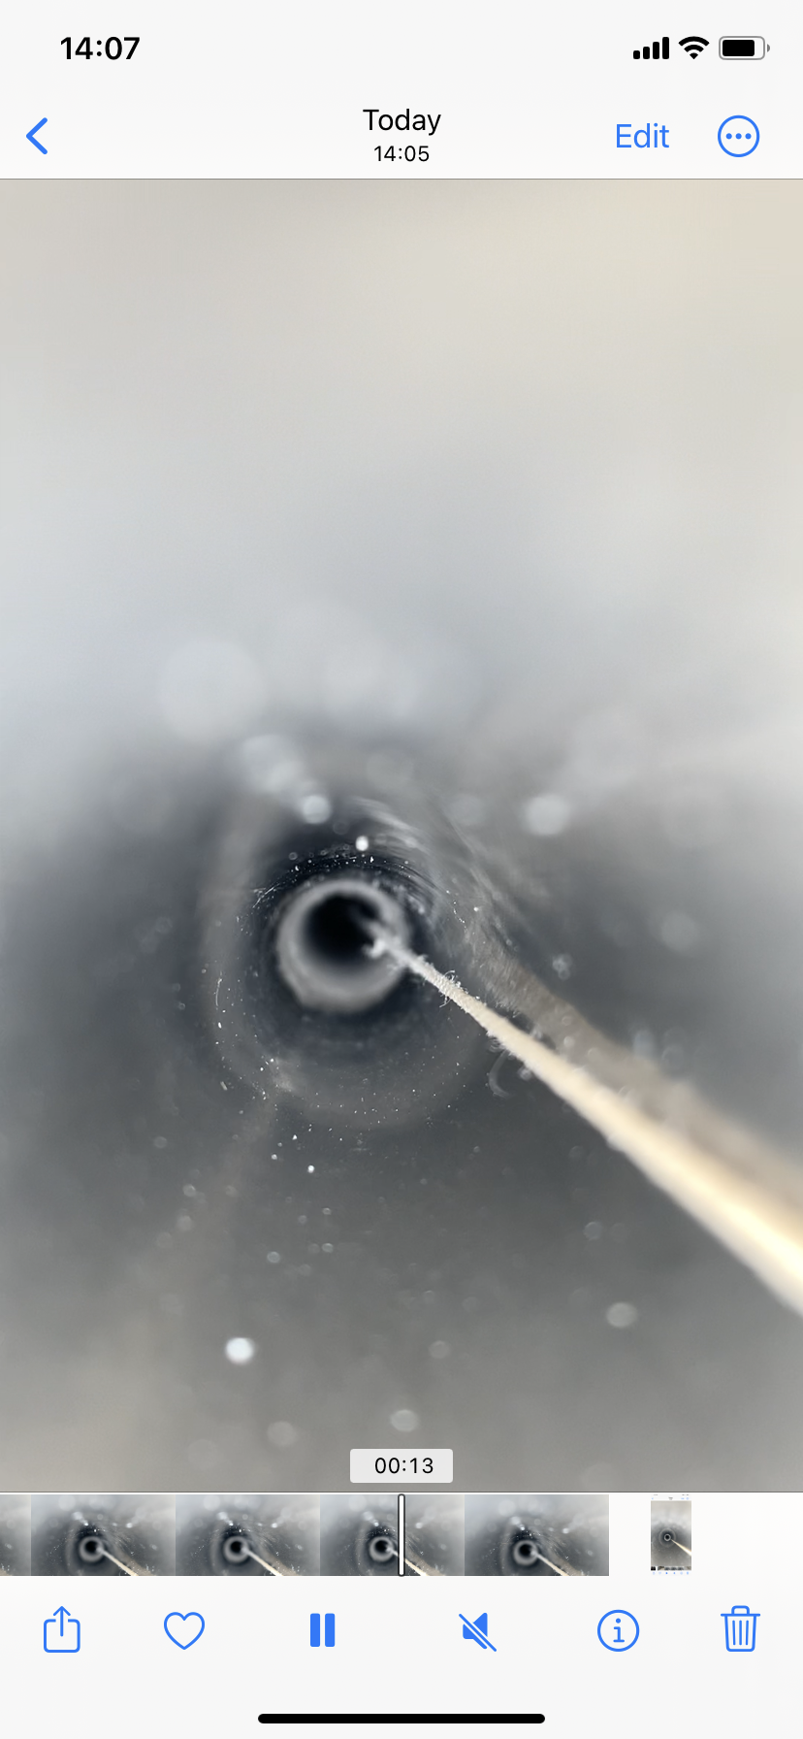
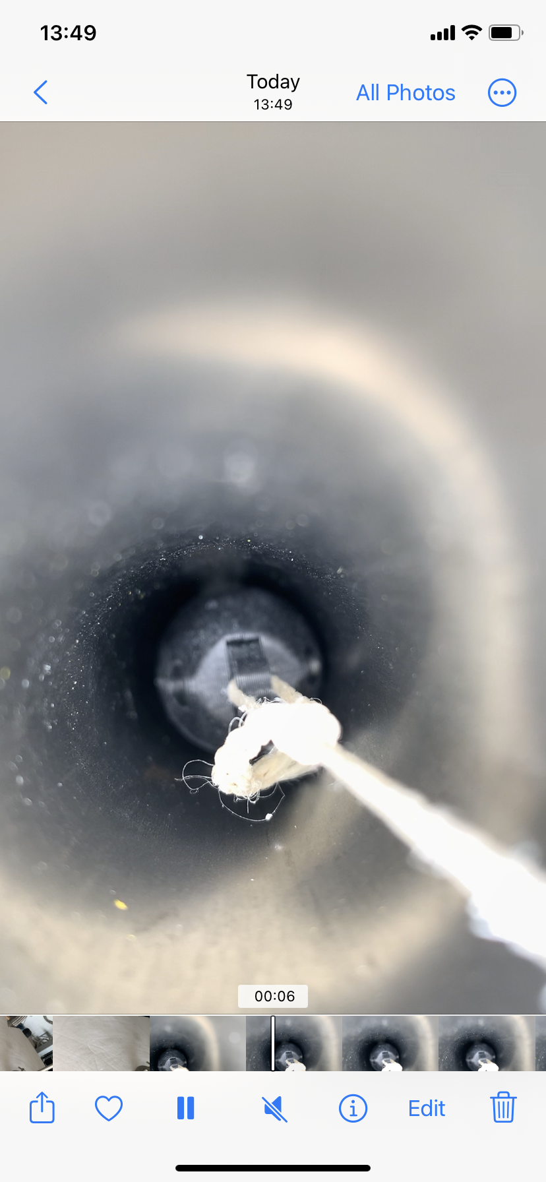
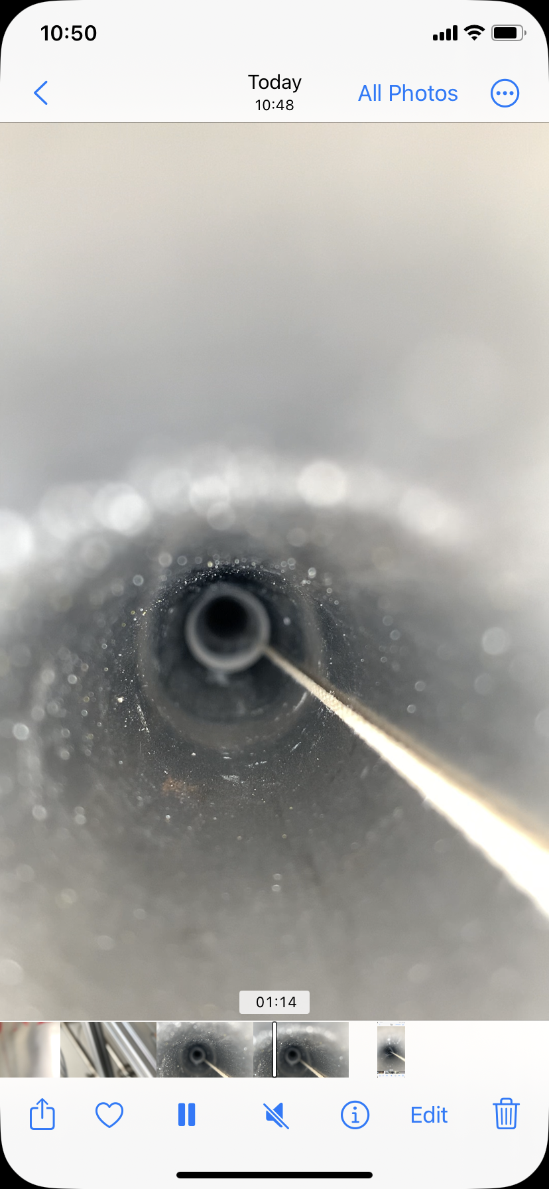
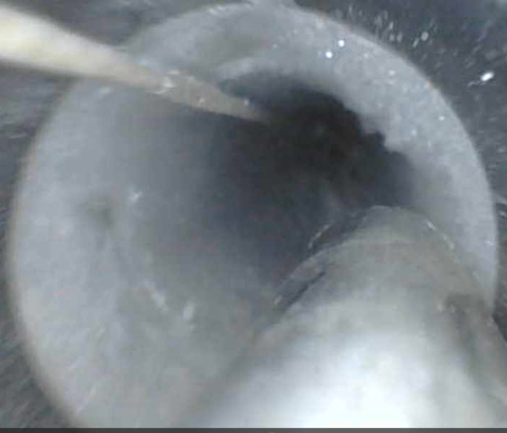
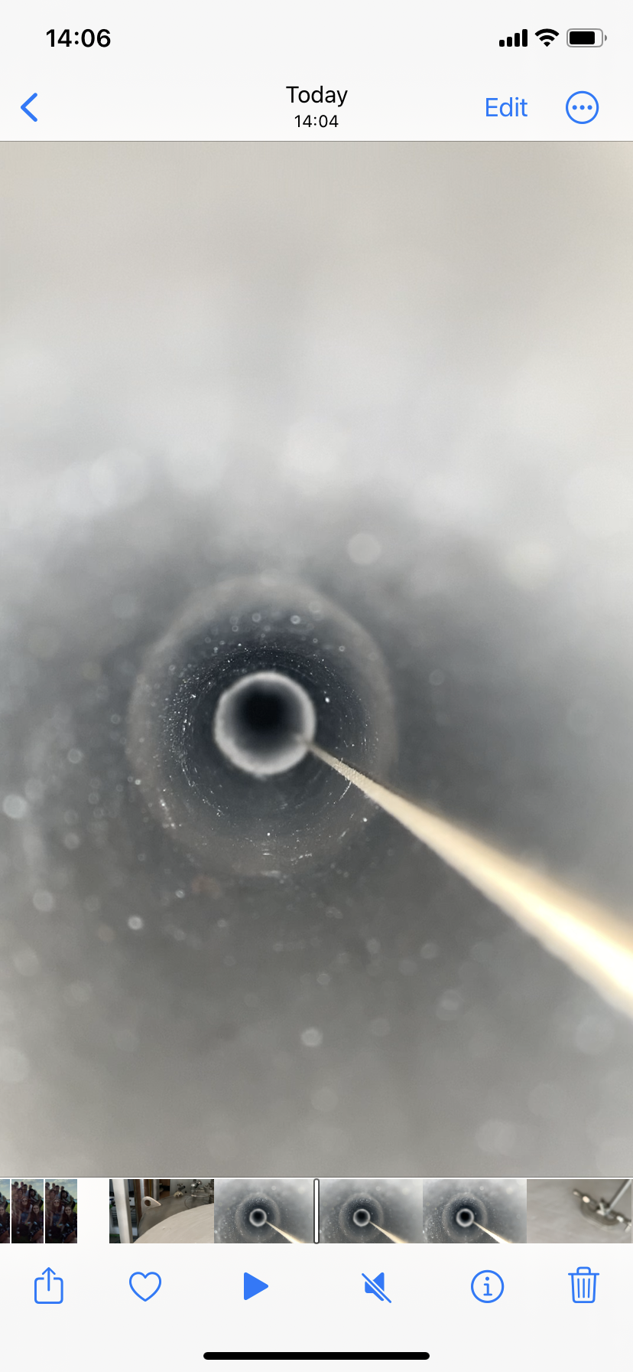
Overall conditions of the test
Ice formation mitigation
Date | Monday 03/07 | Tuesday 04/07 | Wednesday 05/07 | Friday 07/07
Left Side (DS4)
Right Side (DS2)
Blowing into tube (Extreme nonrealistic scenario)
Increase humidity to 100%
Ice formation
➔ After 20h of 120L/h gN2, turns into frost
Ice
Frost
Ice
Pictures are cropped to be visible so do not pay attention on sizes, more on shapes.
The rope on the corner of tube to take the picture, in center usually
Similar conclusion as LN2

Slide 11
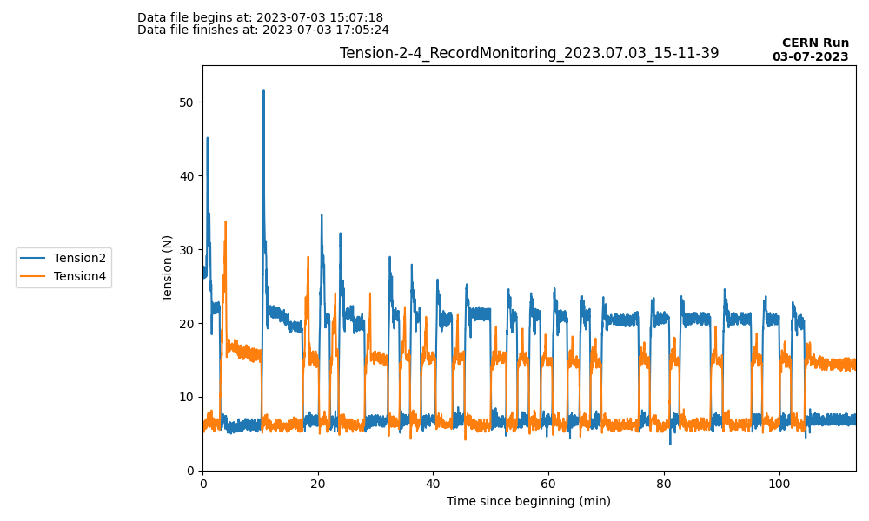
Tension during stress test
11
At beginning, up to 50N due to incorrect motor alignment → Solve by repositioning motors
➔ Tension value stable and comparable to LN2
Repositioning
of motors
Again repositioning
of motors
Avg DS2 tension
after repositioning
21N
Avg DS4 tension
after repositioning
15N

Slide 12
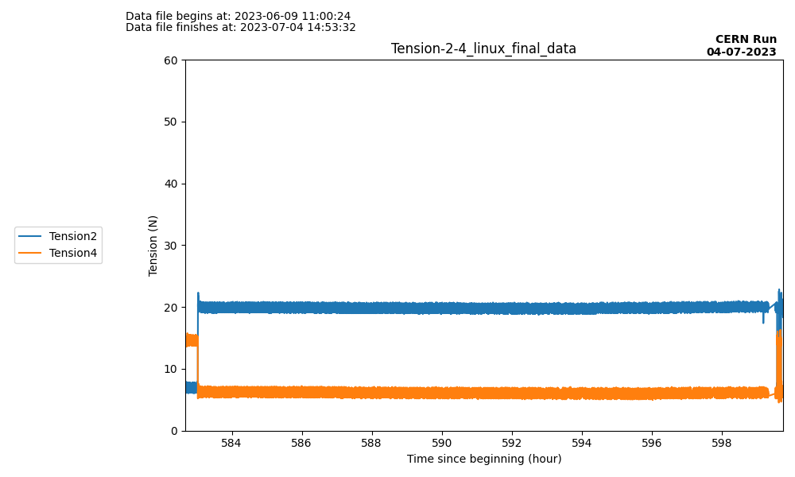
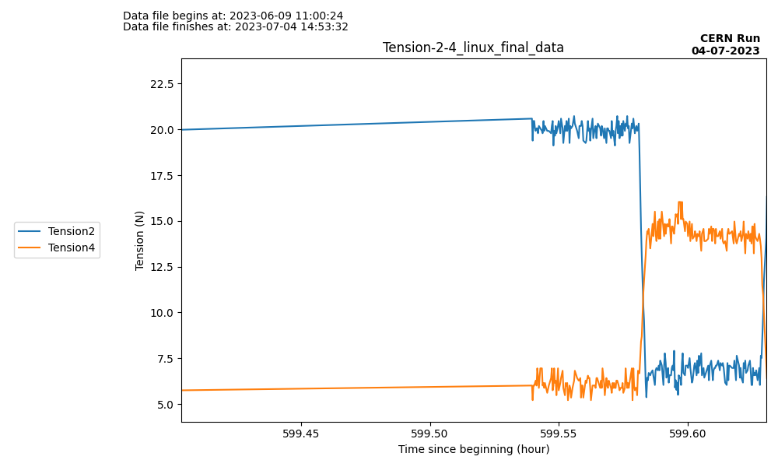
Long stay test
T=15N
Max tension 16N
T=15N
Tension is not related to the duration of the stay at the same position for LAr neither
Source left at D for 16h, no high tension after moving it back to A (DS4)
➔ Same plots when source stays for 5 days at same position

Slide 13
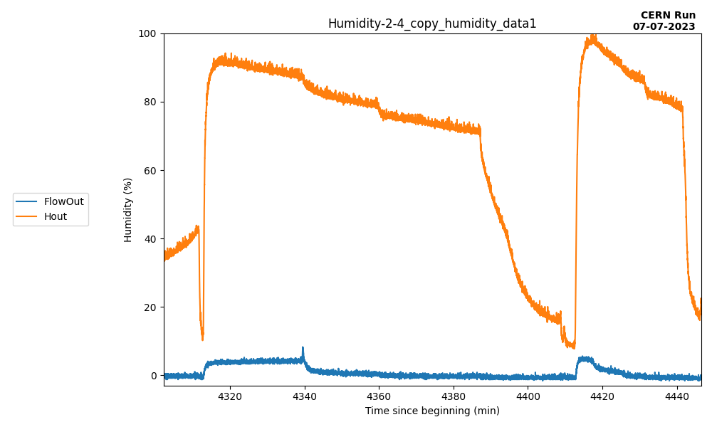
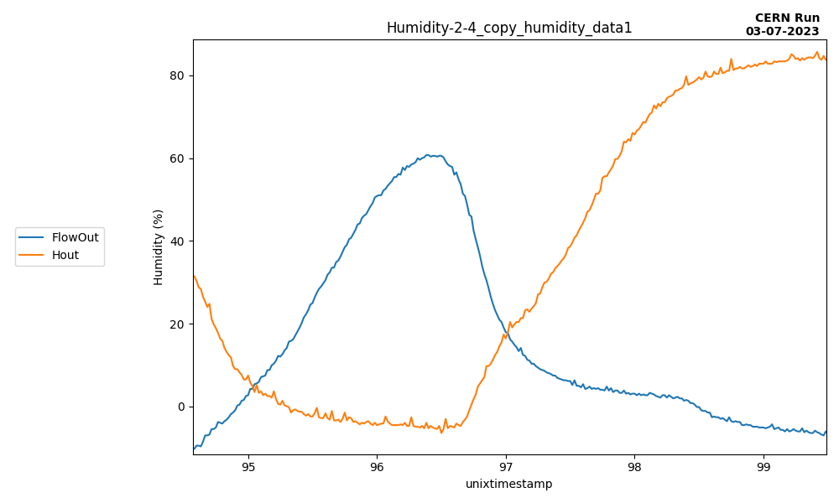
Humidity test without moving source
13
30
60
120
0
30
60
120
0
120
gN2 flushing (L/h)
Vary gn2 flushing F and measure humidity when source at two positions : top-left (D), bottom (A)
Determine F which remove humidity “instantly” (<=5min) → F_{threshold}
Source Top-left : V_{before} small → 60 < F_{threshold} < 120 L/h ➔ Measure : F_{threshold} = 100L/h
Source Bottom: V_{before} larger → 120 < F_{threshold} < 250 L/h ➔ Measure : F_{threshold} = 150L/h
V_{before}(D)
4xV_{before}(D)
D
Source
D
C
C
B
B
Source
A
A
Reset Flushing 250L/h
DS4 (left)
DS2 (right)
➔ Assuming same scaling, F_{threshold} for DS20k with source at bottom might be around 300L/h
Source position at A
Source position at D

Slide 14
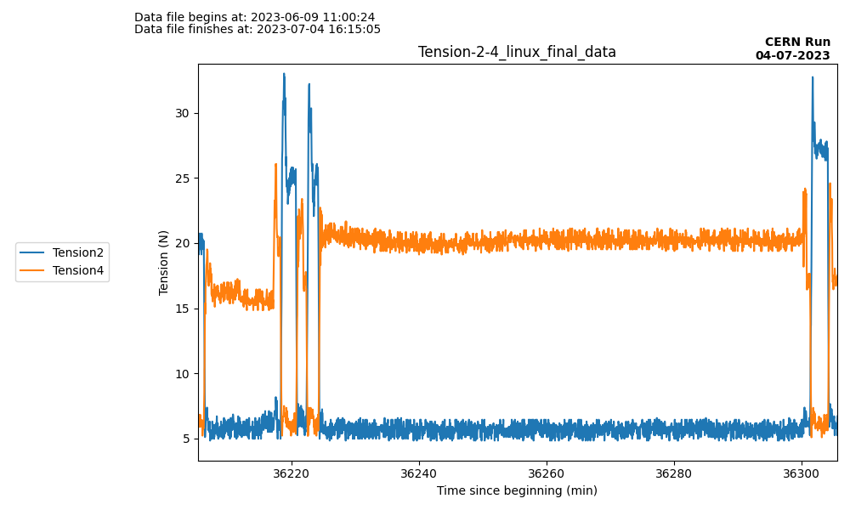
Humidity test when moving source 1/2
14
Humidity at 100%
Humidity at 0%
D
Blow in tube from both sides → After 5min, both humidity are at 100%
B → D → B : +12N/+11N wrt normal
gN2 at 120L/h, put back top caps → After 1h30, both humidities at 0%
B → HG* → CG* : +12N/+9N wrt normal
C
B
Source
Avg DS2 tension in normal conditions
21N
A
Avg DS4 tension in normal conditions
15N
D
D
D
D
B
B
B
B
B
B

Slide 15
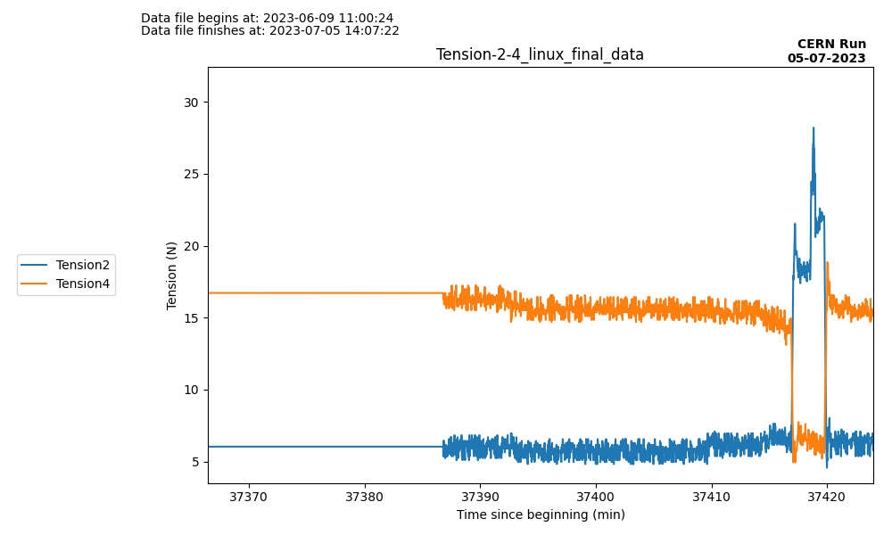
Humidity test when moving source 2/2
15
Pseudo-source in position D for 1 night
D → +5cm → -5cm : +8N/+5N wrt normal
Data from previous slide
18h before
Avg DS2 tension in normal conditions
21N
➔ With long-time flushing, maximum tension due to ice formation decreases
Avg DS4 tension in normal conditions
15N
+5cm
-5cm
D
D

Slide 16
Ice formation conclusion
Everything should be done not to introduce any humidity in the tube → This will be achieved by the glove box design, flushing gN2 and the strict procedure foreseen for its usage
By default, gN2 should be flushed continuously in the tube→ should be O(100) L/h
In case humidity is inadvertently introduced in the tube*, it will gradually be clustered on the tube internal surface. As demonstrated by the mock-up, increasing gN2 flushing will mitigate the situation
* Note that with the plastic top cap used for the mock-up, this was the case, explaining why a thin layer of frost is visible even when flushing gN2.

Slide 17
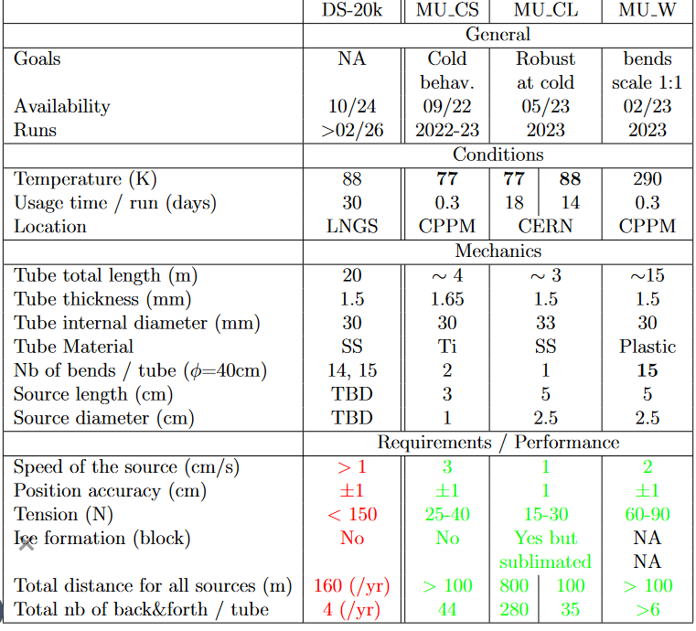
Conclusion
Run at CERN for one month (18 days LN2 / 14 days LAr) ➔ COMPLETED
Liquid in the tube 50cm from top with LN2 → Not observed for LAr
Ice formation mitigated using gN2 → Frost
Average tension 15-30N during stress test
Small impact on tension when stopping the source during long periods.
Robust behavior of calib system at LN2 and LAr temperature for 2 weeks each

Slide 18
BACK-UP

Slide 19
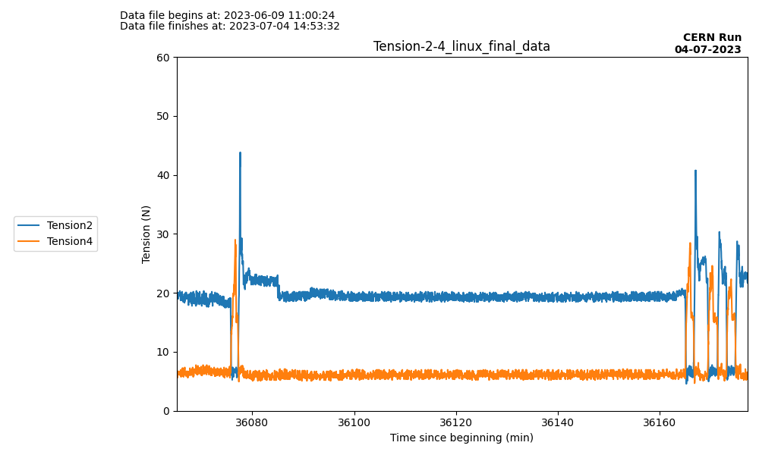
Humidity test 2/3 – Moving source at A
19
Humidity at 100%
Humidity at 0%
Pseudo-source in position A
Blow in tube from both sides to increase humidity at maximum and remove gN2 = Extreme nonrealistic scenario
After 5min, both humidity are at 100%
A→ D → A : +23N/+15N wrt normal
After 15min, put back the top caps and gN2 at 120L/h
After 1h30, both humidities at 0%
A→ D → A : +20N/+15N wrt normal but back to normal after 3 times
Avg DS2 tension in normal conditions
21N
Avg DS4 tension in normal conditions
15N
D
D
D
D
A
A
A
A
A
A

Slide 20
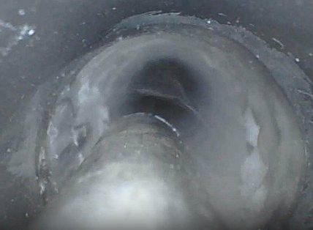
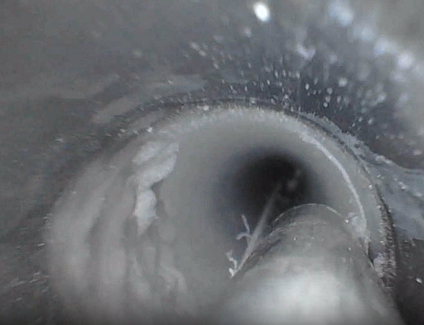
Ice/Frost identification (on DS2)
20
Correct thickness
Illusion of thickness
due to camera
Frost pieces coming off
Soft frost removed with the stick
The top part is frost (~1mm thick) Same on DS4

Slide 21
Liquid Nitrogen tests

Slide 22
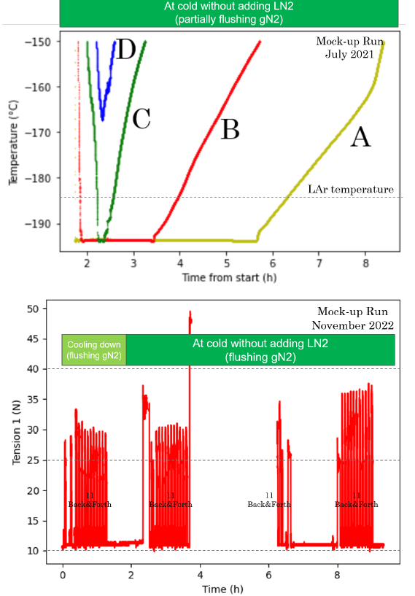
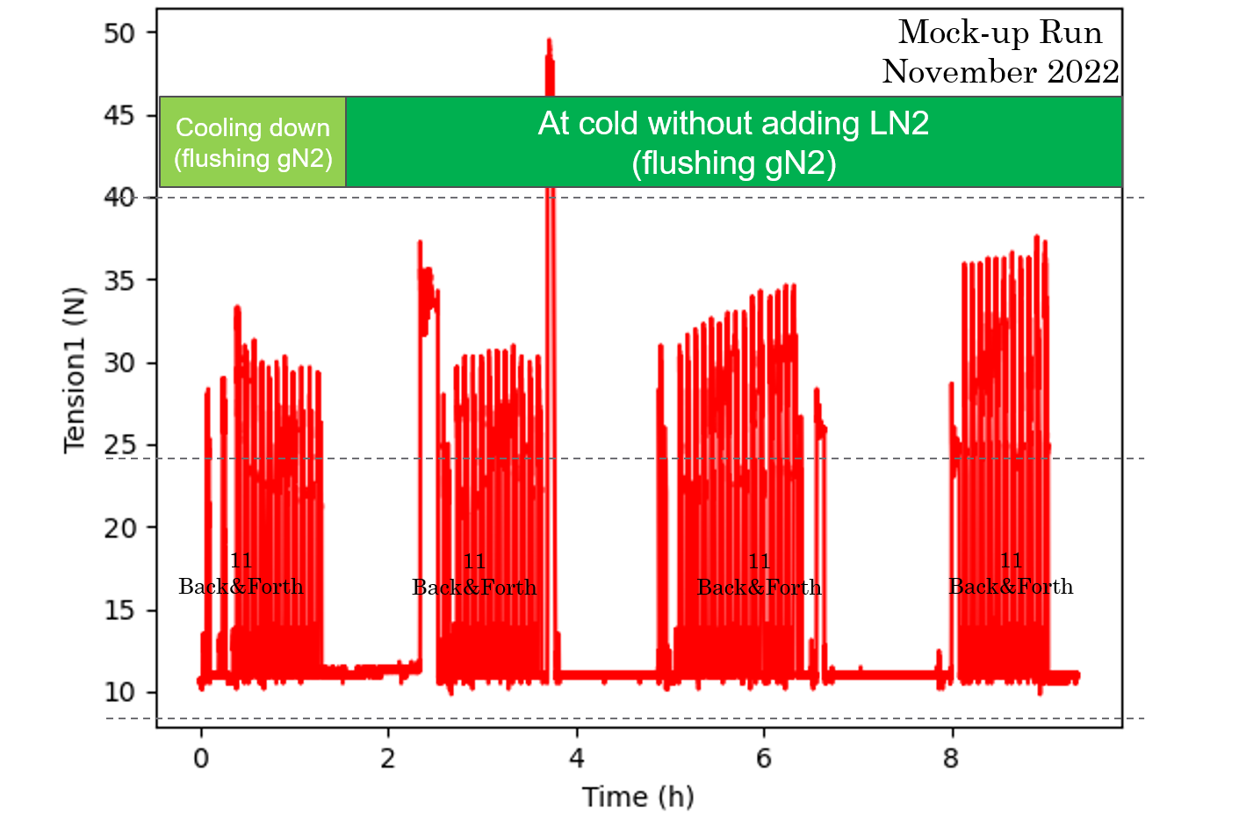
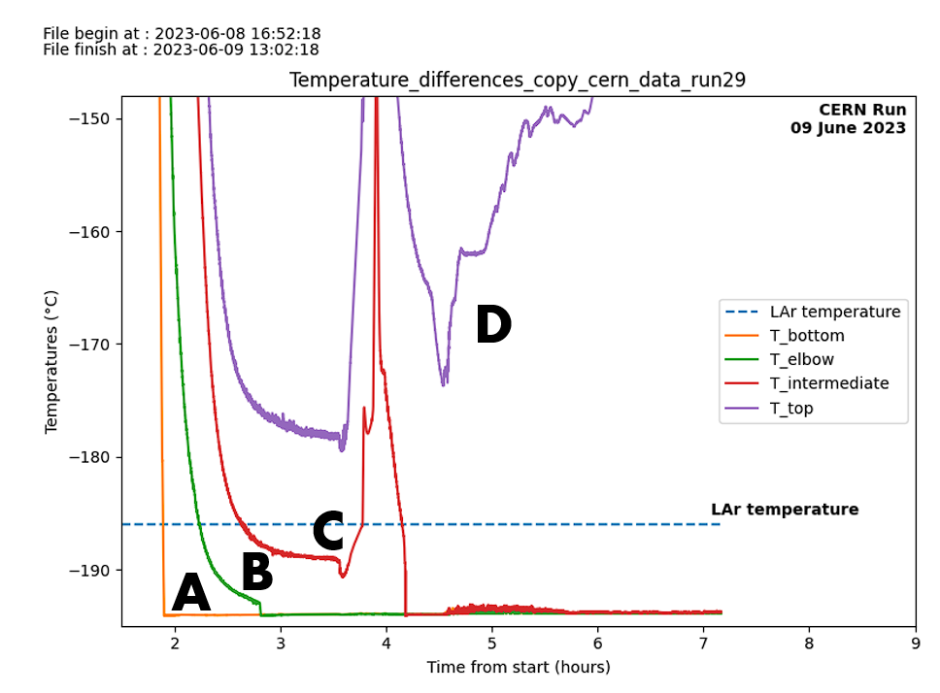
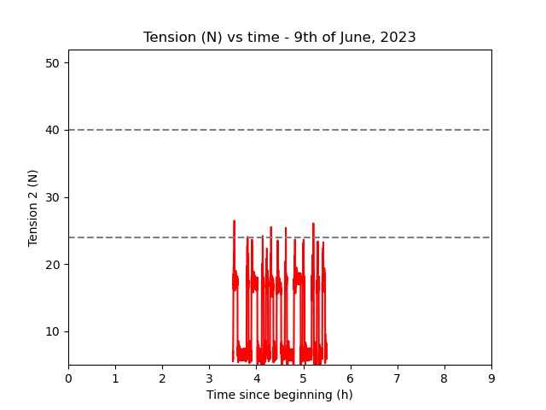
Mock-up
Comparison with CPPM MOCK-UP (first 8 hours)
RUN | Temperature of A, B, C, D | Tension | Conclusion
CPPM short run, Poorly isolated cryostat (0.16 m³) |  |  | Left gN2 flushing at 60L/h T_{A} <= T_{LAr} for only 5h after filling Tension 12-40N
CERN long run, Vacuum isolated cryostat (0.4 m³) |  |  | Left gN2 flushing at 60L/h T_{A}, T_{B}, T_{C} always below T_{LAr} once filled Tension 5-25N
Dewar1
Dewar2
Motorized Systems work at CERN.

Slide 23
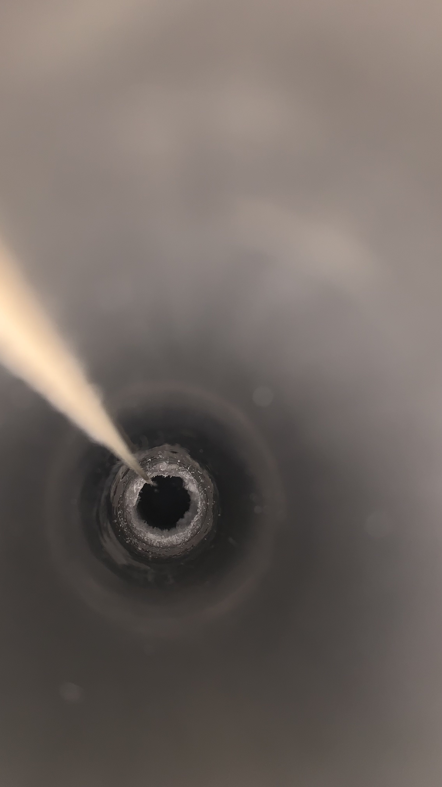
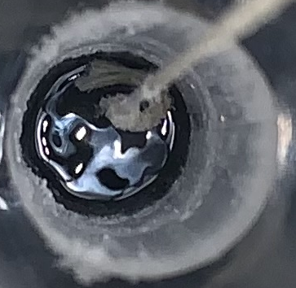
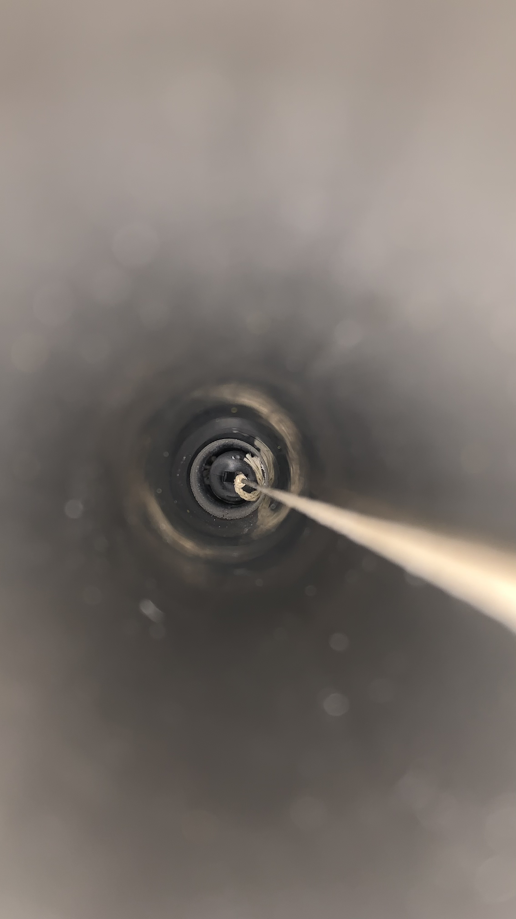
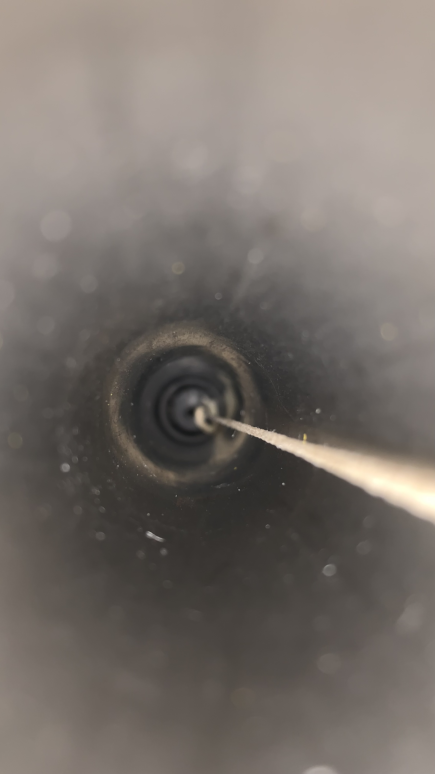
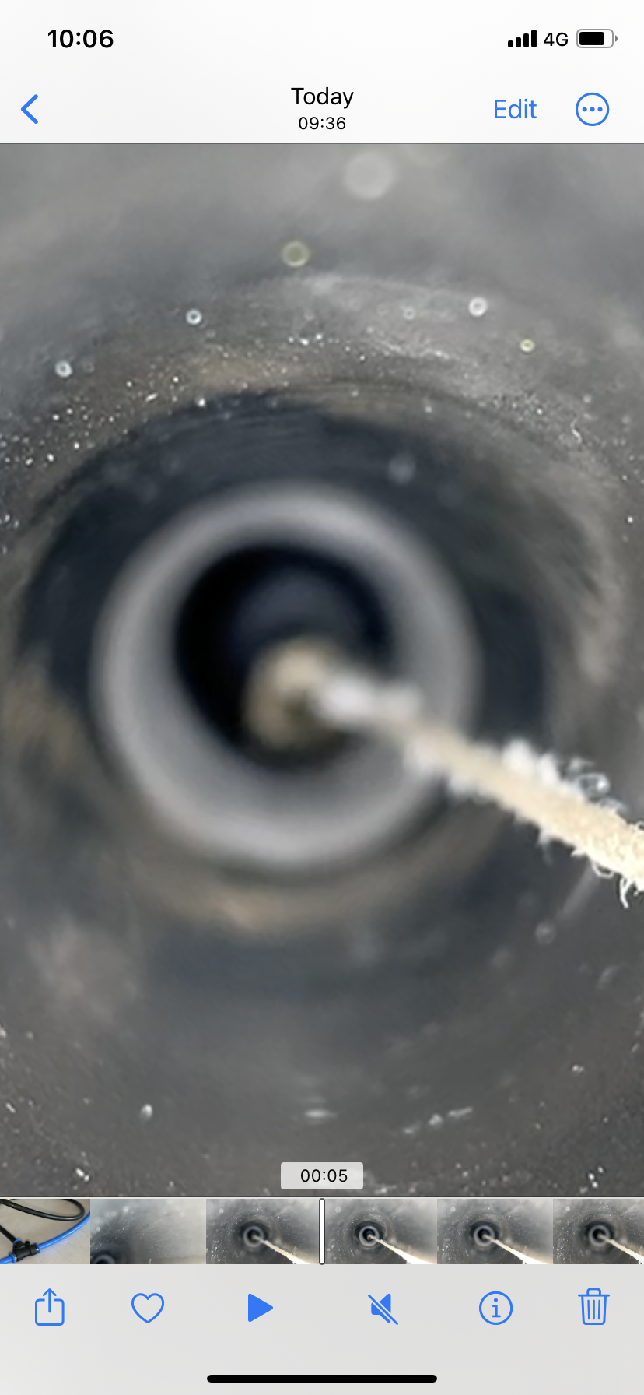
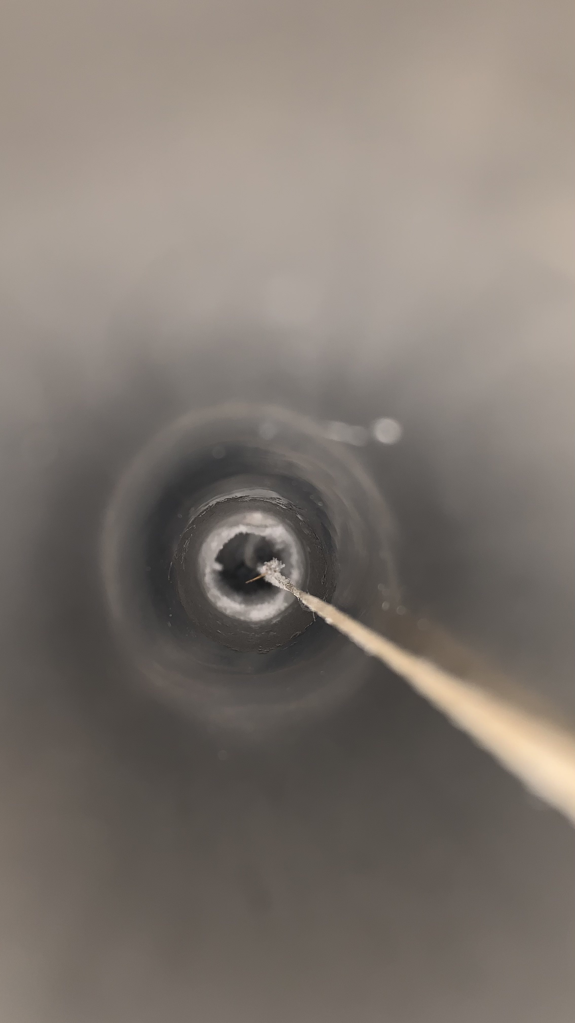
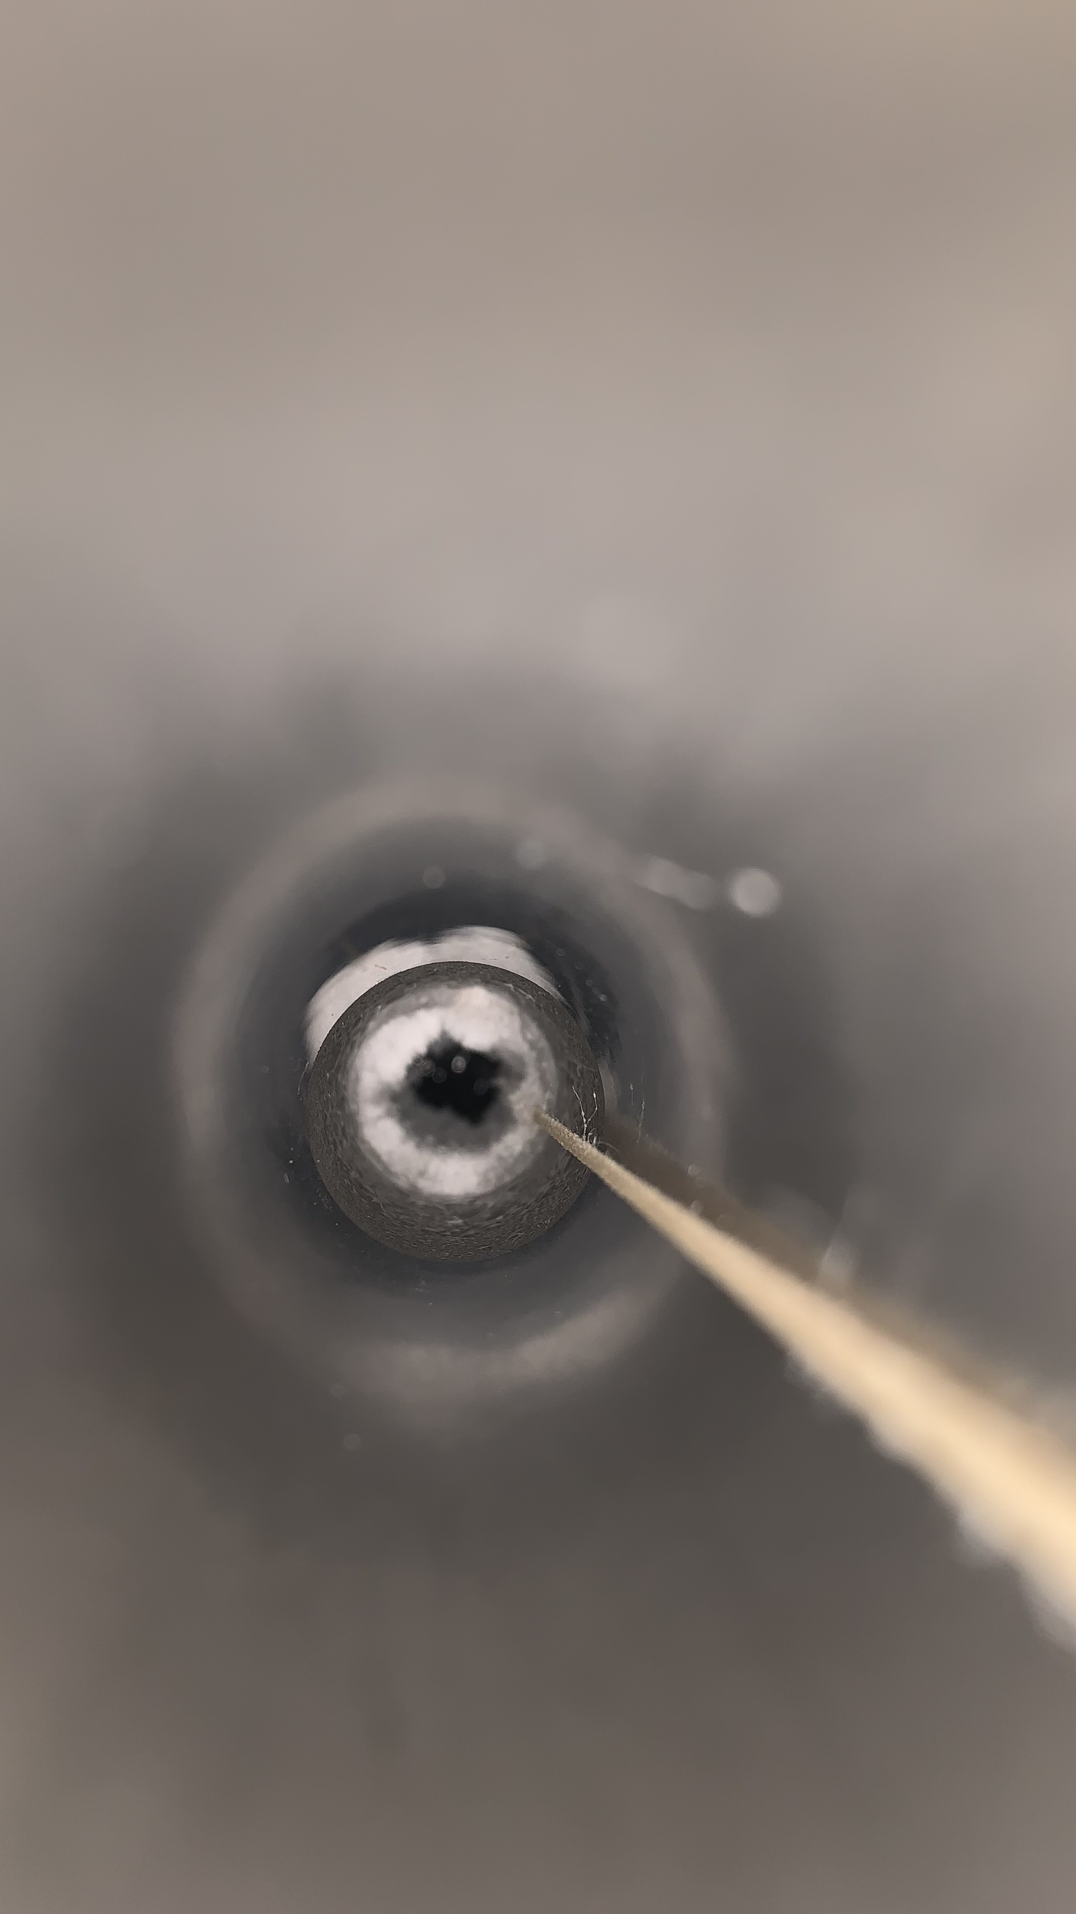
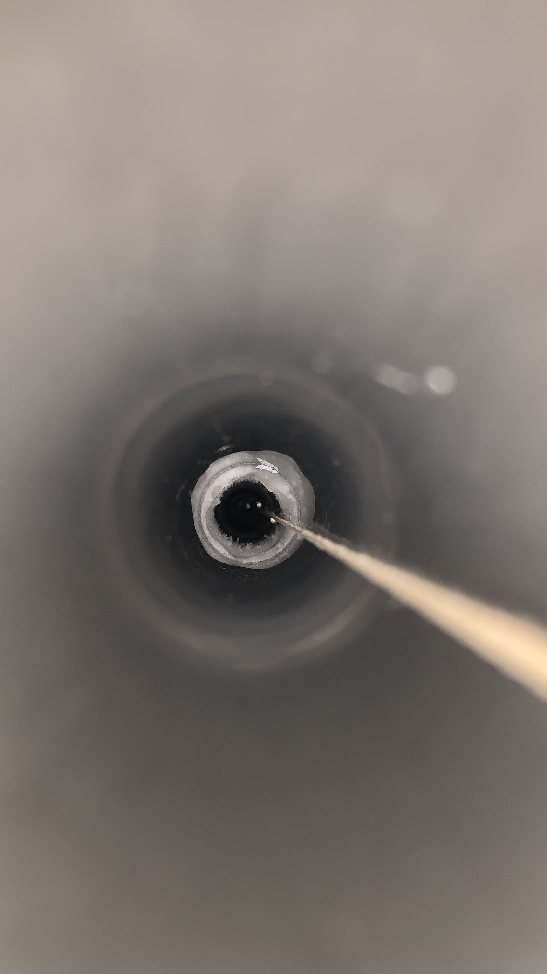
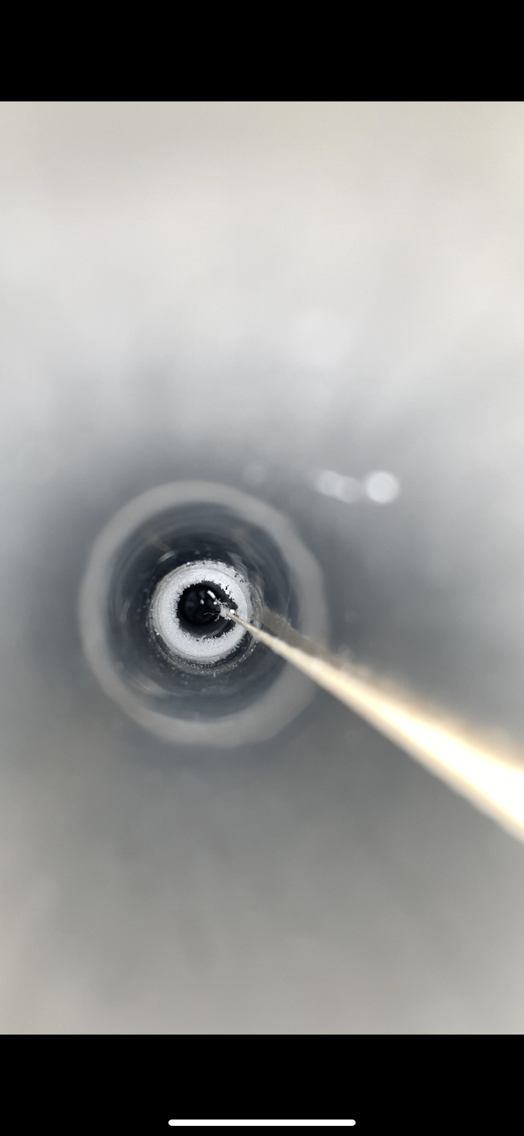
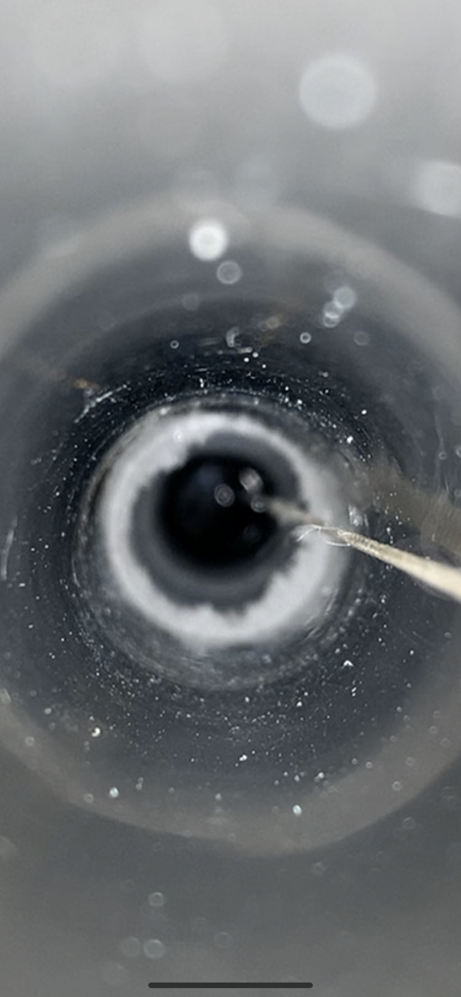
Overall conditions of the test
Ice formation mitigation
Date | 09/06 | 10/06 | 12/06 | 13/06 | 26/06
Left Side (DS4)
Right Side (DS2)
1- Ice formation on both sides (09/06) ➔ Flush hot gN2 on left at 250L/h (4x nominal)
➔ Left side ice turns into frost
2- LN2 inside (-50cm) tube prevent gN2 to reach right side ➔ T pipe to flush left and right (250L/h)
➔ Ice on right side turn into frost
LN2
Frost
Frost
Ice
(T)
(T)
Pictures are cropped to be visible so do not pay attention on sizes, more on shapes.
The rope on the corner of tube to take the picture, in center usually
Ice turns into frost after 1 day of
large gN2 flush on both sides ➔ Stable conditions for test

Slide 24
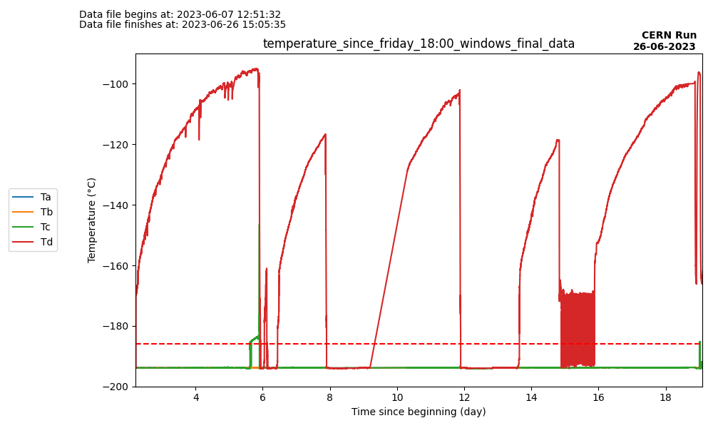
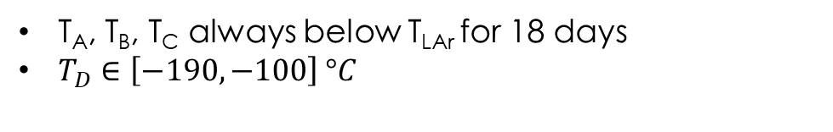
Test conditions for LN2 (18 days)
Temperature of PT100 and tank filling
Prepa
Stable
End of cooling
300
D
250
Tank refills
Slope
0.5%/h
200
gN2 flow (L/h)
150
100
A,B,C
50
0
Filling process is automatic (no auto-filling on the weekends and on Wednesday)
Flushing at 120L/h (2x60 with T)
T_{A}, T_{B}, T_{C} always below T_{LAr} for 18 days
$T_{D}∈\left[−190, −100\right] °C$

Slide 25
Stress test with LN2
Program
DS4
DS2
The goal is to check robustness of the Mock-up
Back and forth (b&f) from the cold garage to PT100 A (2x 1,3m) with a ~1min stop at the edges (~1 cm/s)
35 b&f/day (~3h) for 8 days In DS20K, 8 sources so 4b&f and 20m tube → 280 b&f ➔ 70x DS20k → ~740m ➔ 5x DS20k
Cold Garage

Slide 26
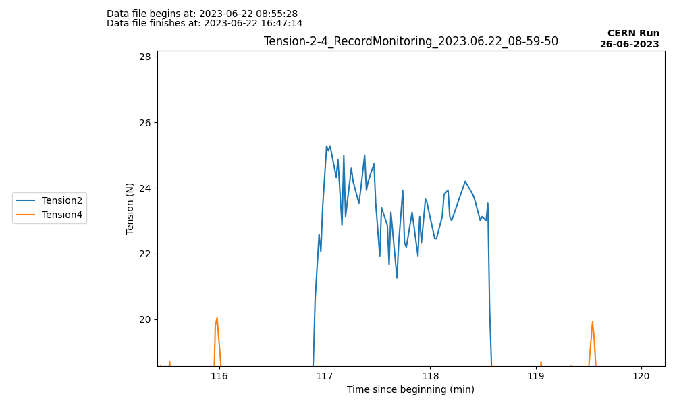
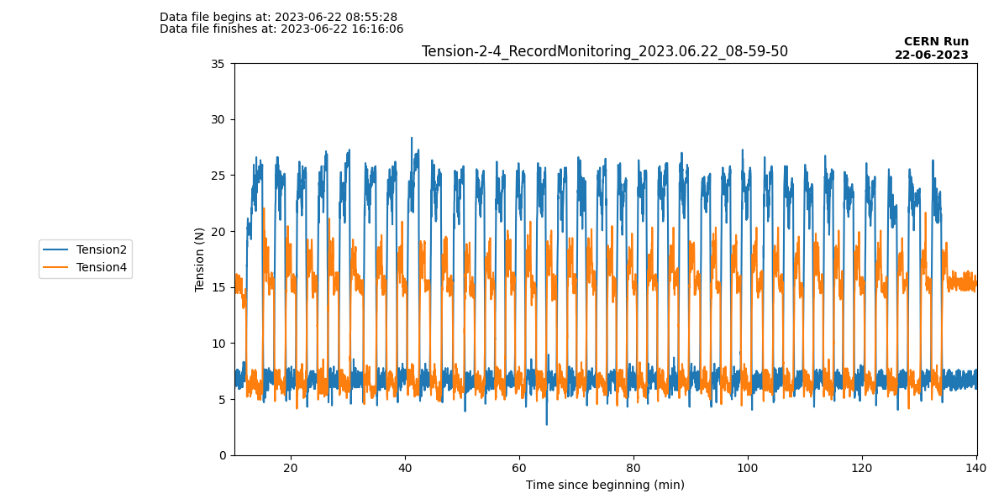
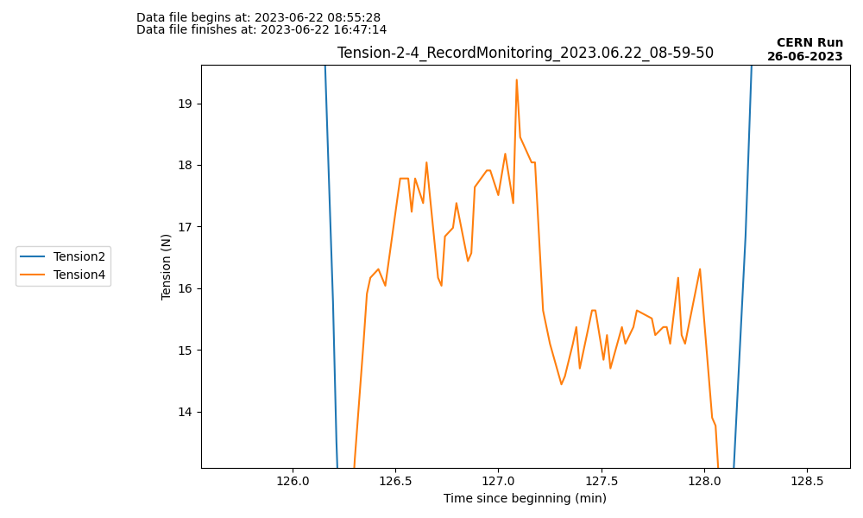
Stress test with LN2
TYPICAL RUN
2 typical tension depending puller motor
Tension ~23N
90s
Tension ~16N
Typical tension for DS2
6N
Following motor’s tension
DS4
Cold garage
DS2
DS2 tension around 24N, no visible impact of tube geometry
DS4 tension lower, and reflects the tube geometry
D
In tube LN2 level
C
B
A
Typical tension for DS4

Slide 27
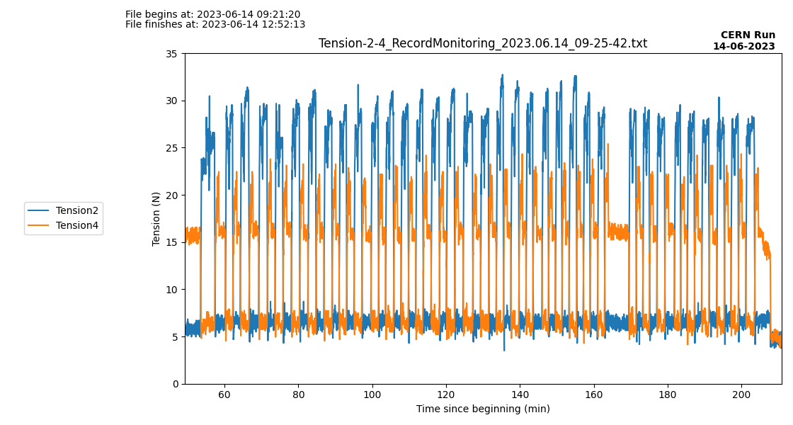
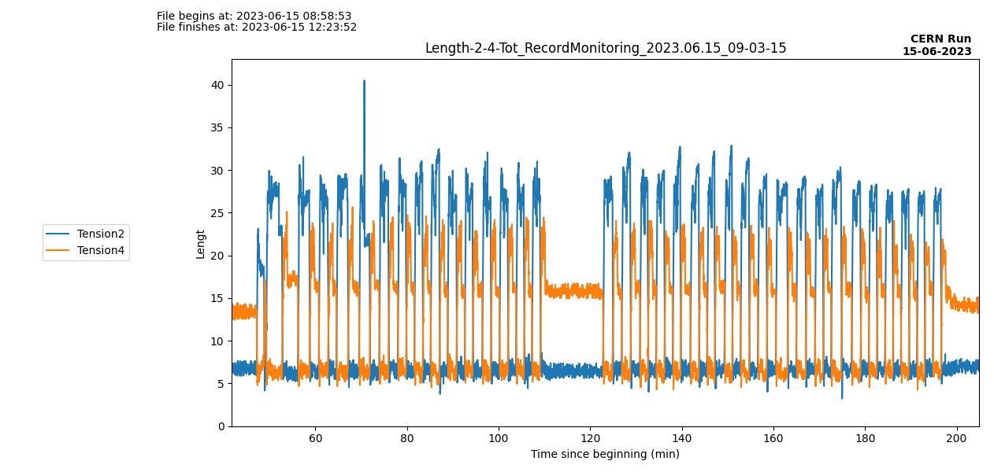


Stress test with LN2
Results (First week)
10min break during the test
40N spike
23,5°C/40%
23,5°C/40%
24,5°C/43%
25°C/40%
Tension ~23N
Tension ~16N
6N
Following motor’s tension
13/06
14/06
15/06
16/06
DS2 tension : two days at 25-30N at worst

Slide 28



Stress test with LN2
Results (Second week)
10min break during the test
24,5°C/47%
25°C/54%
26°C/53%
24°C/60%
Tension ~23N
Tension ~16N
6N
Following motor’s tension
19/06
20/06
21/06
22/06
The tension is stable

Slide 29
Long stay test with LN2
Program for the test
The goal is to check how the motors react when the source is left for a long time at a PT100 step.
We left the source at different spots for different periods of time (1min, 10min, 30min, 1h, 2h, a night, a weekend)
Source | ⁵⁷Co | ¹³³Ba | ²²Na | ¹³⁷Cs | ⁶⁰Co | AmBe | AmC | AmLi
Energy (keV) | 122 | 356 | 511 | 662 | 1173 | [0.2, 12] | [2, 7] | [0, 2]
Activity (side) (kBq) | 18 | 1,9 | 0,36 | 2,2 | 0,36 | 0,14 | 0,15 | -
Activity (bottom) (kBq) | 100 | 5 | 0,67 | 4,6 | 0,6 | 0,18 | 0,18 | -
Duration of calibration (h) | 3,84 | 18,72 | 23,52 | 36 | 74,4 | 200 | 200 | -
Time on each spot | 12’ | 1h50’ | 2h20 | 3h45’ | 8h | 22h | 22h | -

Slide 30


Long stay test with LN2
Tension after stop
1min
10min
30min
C
D
B
A
B
C
A
Tension plot during one test
When the source is moved from its staying position, extract maximal tension 10s after the start of the move

Slide 31
Long stay test with LN2
Tension after stop
Tension is not related to the duration of the stay at the same position

